Slide 1

FAKE REVIEWS IDENTIFICATION

Slide 2
INTRODUCTION
This system will find out fake reviews made by posting fake comments about a product. User will login to the system using his user id and password and will view various products and will give review about the product. To find out the review is fake or genuine, system search a user who gave same review on any products and admin can delete it.

Slide 3
PURPOSE OF PROJECT
The purpose of this application is to predict the fake reviews. Online shopping is the technique where the customers buy the goods directly from the seller, over the internet. So, the customers make the decision of buying the product based on the reviews posted. The fake reviews can mislead the customers on buying the wrong product. The main objective here is to delete the fake reviews.

Slide 4

ADVANTAGES
User can buy a product.
User gets genuine reviews about the product.
User can post their own review about the product.
User can spend money on valuable products.

Slide 5
MODULES in a project
Admin Module -
See All Reviews
Delete Reviews
User Module -
View product:
Buy the product:
Post Review:

Slide 6
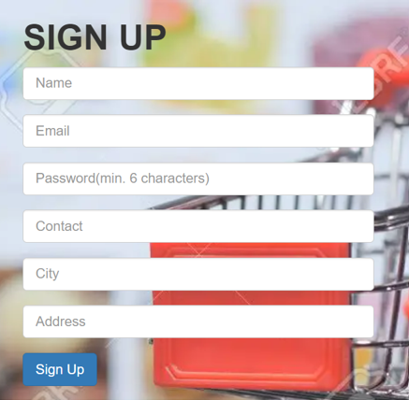
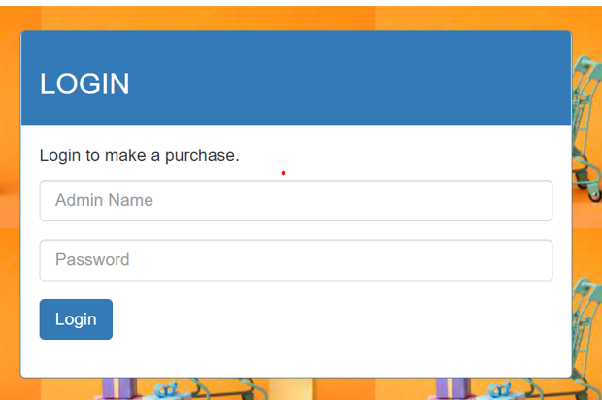
Interface Design

Slide 7
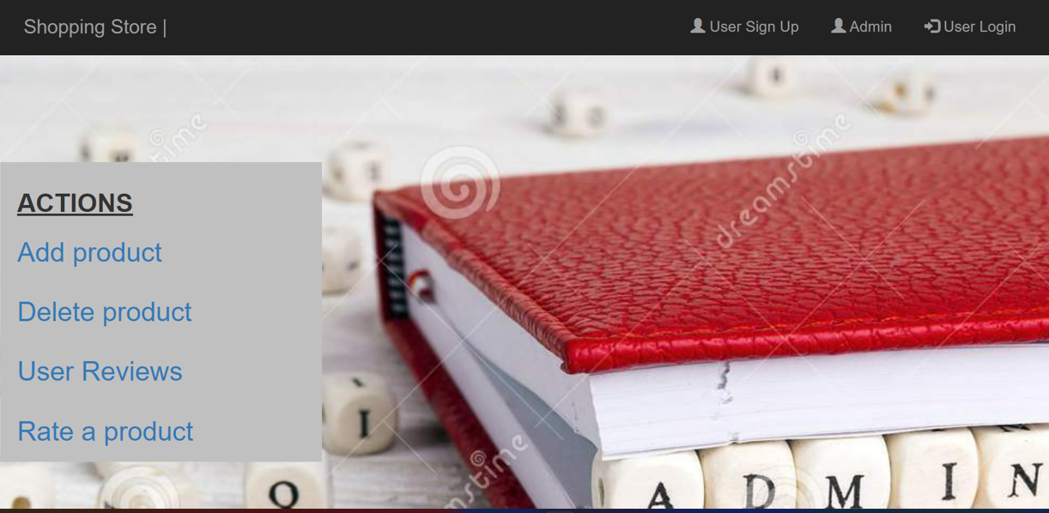
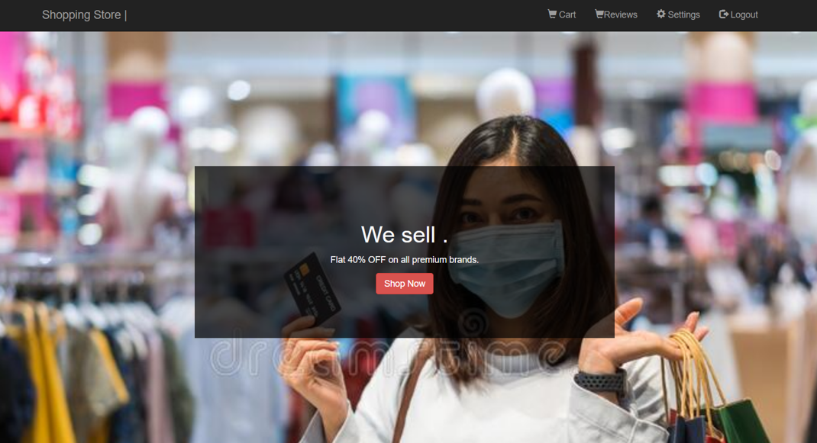
Admin home page
Interface Design
USER HOMEPAGE

Slide 8
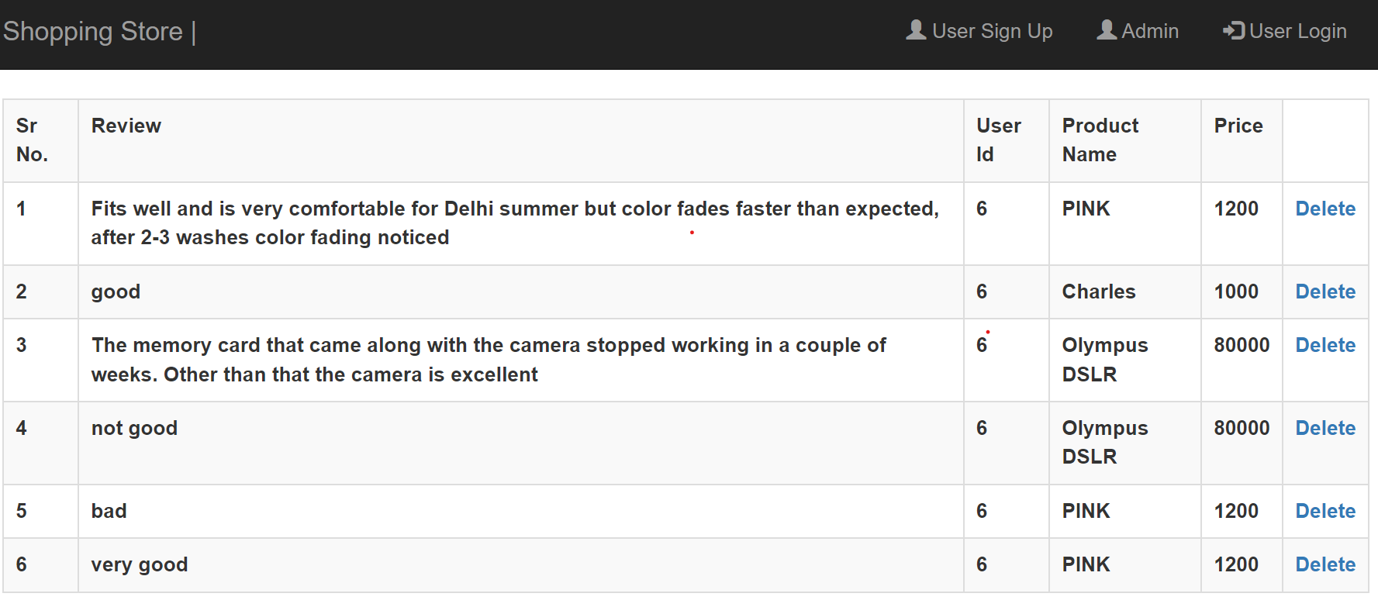
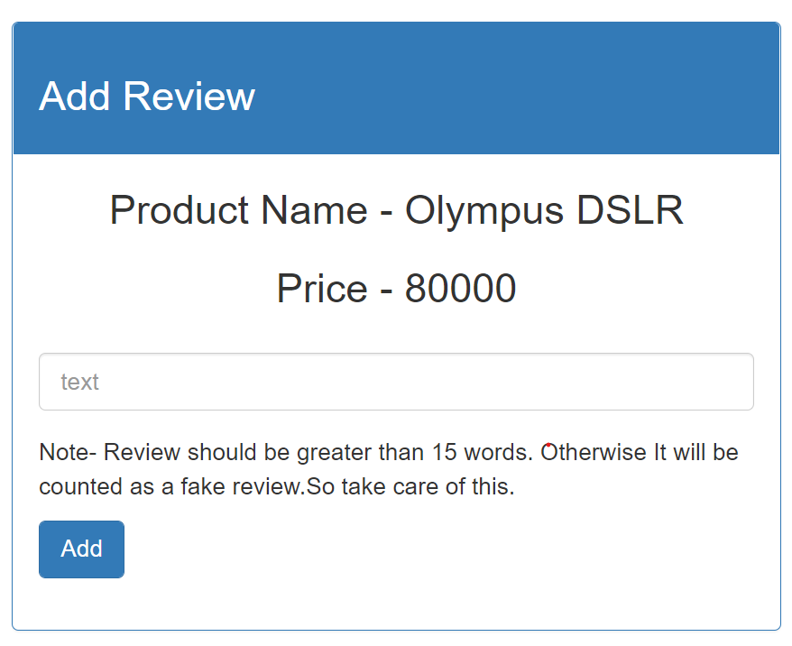
Review page

Slide 9
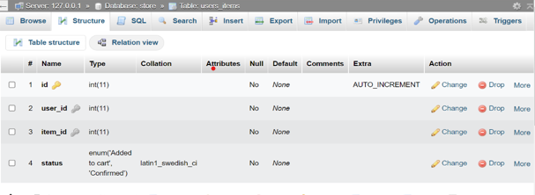
Database tables
ADMIN TABLE
USER TABLE
PRODUCT TABLE
USER’S PRODUCTS
REVIEWS

Slide 10
WORKING OF A SOFTWARE
User will register yourself to the website.
Then User can login using the user id and password.
User once access the system; user can view product and can post review about the product.
User can add the products into a cart and place an order.
User can also put a review on the buying products.
Admin will login and see all the reviews.
System will track the user id of the user.
If the system observes fake review coming from same id address many a times this id address will be tracked by the system and will inform the admin to remove this review from the system.

Slide 11






USER FLOW CHART
USER
REGISTRATION
USER
REGISTRATION
LOGIN
LOGIN
BUY A PRODUCTS
ADD PRODUCT TO A CART

Slide 12
ADMIN FLOW CHART
ADMIN
LOGIN
SEE ALL THE REVIEWS
IF NOT REAL THEN DELETE

Slide 13







Software Requirements
Front End
HTML5, CSS3, Bootstrap
Back End:
PHP, MYSQL
Android Tools:
IDE: VS code
PHP Tools:
xampp-win32-5.5.19-0-VC11

Slide 14
Hardware Requirements:
Processor: Intel(R) Core (TM)
Installed RAM: 8 GB
Hard Disk: 500 GB
Operating System: Windows 7,8,10 - 64 bit

Slide 15
CONCLUSION
Fake Product Review Monitoring & Removal for Genuine Ratings management
reports in PHP. From our work we have come to a conclusion that finding the
opinion spam from huge amount of unstructured data has become an important
research problem. Although, some of the algorithms have been used in opinion
spam analysis gives good results, but still no algorithm can resolve all the
challenges and difficulties faced by today's generation. It is very important to
consider certain quality measures like helpfulness, usefulness and utility while
analyzing each review

Slide 16
THANK YOU….

